Slide 1
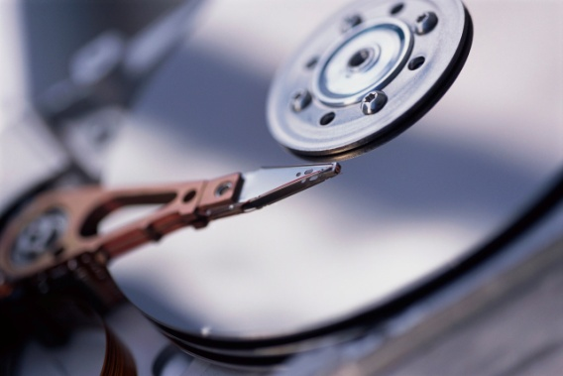

Everything your business needs to know but probably doesn’t

Slide 2

The reality
The average company spends between $100,000 and $1,000,000 per year on data disasters
Nearly 70% of data loss is the result of human error
60% of companies that lose their data will shut down within 6 months of the loss
140,000 hard drives crash in the U.S. weekly

Slide 3
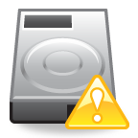
Your responsibility
Adopt the mantra:
“It’s not a matter of if my hard drive fails, but when.”

Slide 4
Data loss prevention
Avoid heat and vibration
- Keep computers in a dry, clean area with little traffic
Run Scandisk, defrag and anti-virus software
- Run Scandisk every 2 to 3 weeks
- Defrag! Data recovery success is more likely when damaged files are clustered
- Update your anti-virus at least 4 times a year and enable auto update features
Use uninterrupted power supply (UPS)
Back up, back up, back up

Slide 5
Data backup
Complete backup
- Full backup of entire PC or hard drive
- Backs up all server and PC volumes, directories and files
Partial backup
- Will either copy all files changed since last complete backup or files changed since last backup
- Useful when it’s important to have the latest version of each file
User-defined backup
- Copies a user-defined set of files
- Useful for groups working on a mission-critical project

Slide 6
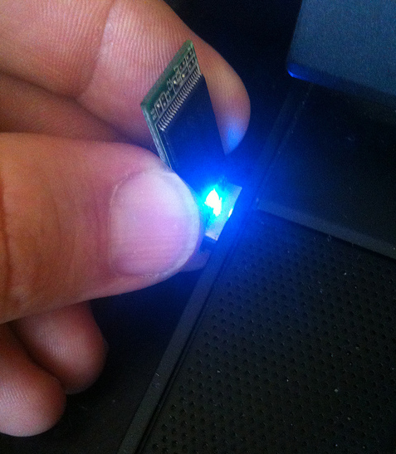
Backup hardware
CDs, DVDs and Blu-Ray disks
- Inexpensive, quick, months to years of storage
Thumb drives
- Inexpensive, quick, larger storage capacity than CDs/DVDs, months to years of storage
Internal hard drive
- Easy transfer from one hard drive to another, many years of storage
External hard drive
- Easy transfer from internal to external hard drive, better connection options, long-term storage

Slide 7
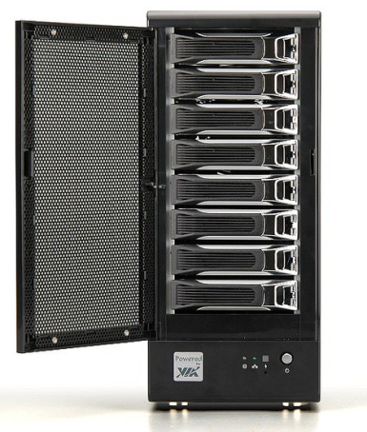
Backup hardware cont.
Online storage
- complete external storage, access from any computer with internet connection, very secure, long-term storage, expensive
Network storage
- complete external storage, access from any computer with internet connection, very secure, large-capacity and long-term storage, expensive

Slide 8
After backup
Complete a data restore
- Run a restore to return backed-up files to their original locations. Do this on a regular basis to ensure the system is actually working.
Maintain offsite copies of your backups
- In the case that your office files are destroyed by fire, lightning damage, flooding or theft, make sure you have multiple, redundant versions of your files elsewhere.
Keep virus protection and Firewall on and up-to-date
- Without the right protection, viruses can be put back onto your computer after backup and your files can be deleted through an unprotected port.

Slide 9

Data recovery
When the unthinkable (but completely possible) happens, and your business is suffering from a failed hard drive, it’s time to prepare for a data recovery service.
Mail only your hard drive and corrupted media to a service professional

Slide 10
Shipping your hard drive
Remove the hard drive from your computer
Package your drive carefully
- Wrap in anti-static material or freezer bag
- Ship in original manufacturer’s packaging in a sturdy, corrugated cardboard box twice the size of the drive
- Use heavy foam padding, bubble wrap and other anti-vibration materials
- Avoid Styrofoam peanuts—they attract static electricity
- Make sure padding material is at least 2 inches thick around drive
Send all other media types the same way

Slide 11
Shipping cont.
For water-damaged hard drives
- DO NOT dry wet hard drives
- Enclose in a damp sponge in a sealed plastic bag
- Recovery is more likely if technicians receive the drive before it has dried
Sending controller boards
- Older models require controllers in order to recover data
- Remove the controller carefully and enclose it in an anti-static material to ship with drive

